Slide 1

Quick Aid Web: A Comprehensive Emergency Solution
Quick Aid Web is a fully online platform that connects individuals in emergencies with local hospitals and nearby trusted contacts, ensuring rapid response and support with no hardware dependencies.

Slide 2

The Problem: Delayed Response in Emergencies
1
Critical Time Lapses
2
Communication Breakdowns
In emergency situations, every second counts. Delayed response can mean the difference between life and death.
Reaching the right emergency services and providing accurate location details can be challenging, leading to prolonged wait times.
3
Lack of Coordination
Coordinating with nearby trusted contacts to provide immediate assistance is often difficult in the heat of an emergency.

Slide 3
Smart Emergency Alerts for Rapid Response
One-Click Emergency Alert
Neighborhood Coordination
Reliable and Secure
With a single tap, users can instantly trigger an emergency alert that notifies nearby contacts and emergency services.
The alert is shared with the user's neighborhood network, allowing for rapid mobilization of support and assistance.
The system is designed to be completely dependable, with encrypted communication and robust fail-safes to ensure critical alerts are delivered.

Slide 4
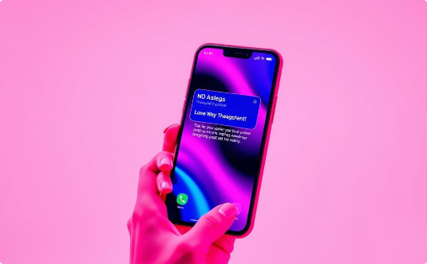
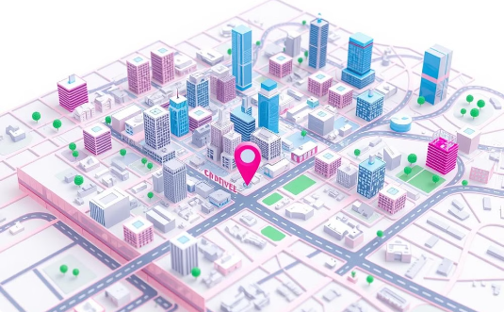

QuickAid's Innovative Approach
Rapid Alerts: Instant Notification
Real-Time Tracking: Accurate Location Data
Personalized Support: Tailored Assistance
QuickAid Web sends alerts to emergency services and your chosen contacts when you need help.
QuickAid Web uses your location to guide responders directly to you, saving time.
QuickAid Web shares your medical and contact information with responders to give you the best care.

Slide 5
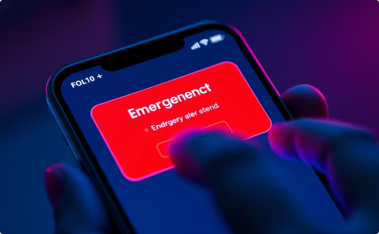
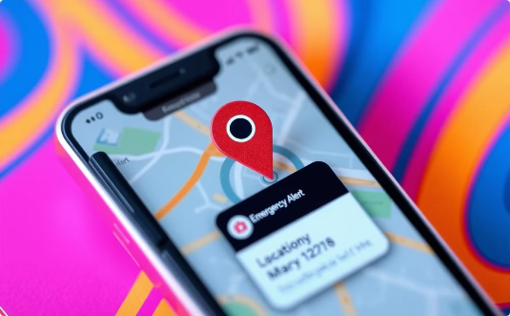

Smart Notifications for Rapid Alerts
Instant Notification
Accurate Details
Timely Response
QuickAid's smart alert system immediately notifies emergency services and designated contacts of the emergency.
The platform automatically provides critical information like location, medical history, and contact information.
With all the necessary details at their fingertips, emergency responders can react quickly and efficiently.

Slide 6

Real-Time Location Tracking for Precise Response
1
Pinpoint Location
QuickAid's advanced location tracking technology accurately identifies the user's position in real-time.
2
Continuous Updates
As the situation evolves, the platform provides constant location updates to ensure a targeted response.
3
Seamless Navigation
Emergency responders can quickly navigate to the user's location using the comprehensive location data.

Slide 7
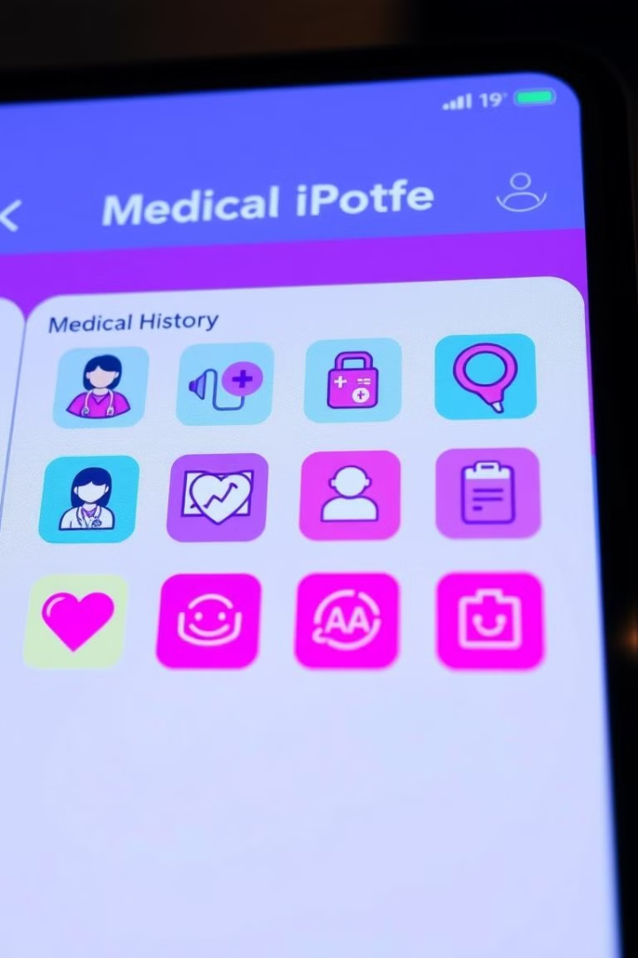



Dynamic Profiles for Personalized Support
Medical History
QuickAid stores critical health information to provide emergency personnel with a comprehensive medical profile.
Emergency Contacts
The platform maintains a list of designated emergency contacts that can be instantly notified.
Personal Details
User-specific information, such as allergies and preferences, is accessible to responders for tailored assistance.

Slide 8




Seamless Integration, No Hardware Needed
Fully Online
QuickAid Web operates entirely online, eliminating the need for any additional hardware or devices.
Accessible Anywhere
Users can access the platform through their preferred internet-connected devices, ensuring 24/7 availability.
Quick Setup
The straightforward setup process allows users to quickly register and activate their QuickAid account.

Slide 9

Reliability and Peace of Mind in Critical Situations
1
Trusted Connections
2
Secure Platform
QuickAid's network of emergency services and designated contacts ensures immediate and reliable support.
The platform's robust security measures protect user data and privacy, providing peace of mind in emergencies.
Comprehensive Solution
3
By seamlessly integrating location tracking, smart alerts, and personalized profiles, QuickAid delivers a comprehensive emergency solution.

Slide 10



QuickAid Blood Donators API: Bridging the Gap in Emergency Care
Empowering Community Donations
Delivering Life-Saving Support
Collaborative Approach
By seamlessly integrating with existing hospital systems, QuickAid streamlines the process of accessing blood donations when they are needed most.
QuickAid fosters a community-driven network, where hospitals, blood banks, and citizens work together to enhance emergency preparedness.
QuickAid's Blood Bank API connects local donors with hospitals in need, ensuring a reliable supply of vital blood products during emergencies.

